Slide 1
Java programming

Slide 2
Procedure oriented Programming:
In this approach, the problem is always considered as a sequence of tasks to be done. A number of functions are written to accomplish these tasks. Here primary focus on ―Functions‖ and little attention on data.
There are many high level languages like COBOL, FORTRAN, PASCAL, C used for conventional programming commonly known as POP.
POP basically consists of writing a list of instructions for the computer to follow, and organizing these instructions into groups known as functions.

Slide 3
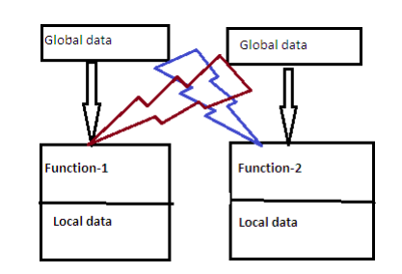
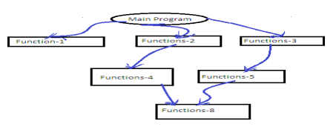

Slide 4
OOP: OOP allows us to decompose a problem into a number of entities called objects and then builds data and methods around these entities.
OOP Chars:
Emphasis on data .
Programs are divided into what are known as methods.
Data structures are designed such that they characterize the objects.
Methods that operate on the data of an object are tied together .
Data is hidden.
Objects can communicate with each other through methods.
Reusability. Follows bottom-up approach in program design

Slide 5
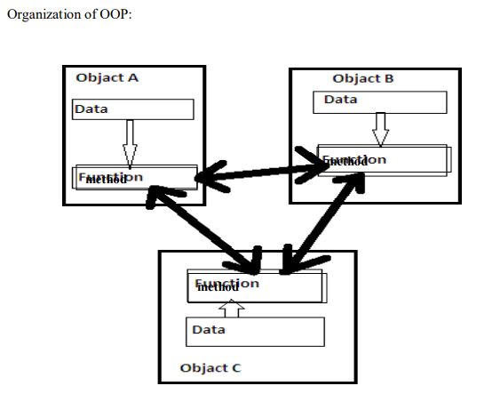

Slide 6
Java programming
Java is an object-oriented programming language developed by Sun Microsystems, and it was released in 1995.
James Gosling initially developed Java in Sun Microsystems (which was later merged with Oracle Corporation).
Java is a set of features of C and C++. It has obtained its format from C, and OOP features from C++.
Java programs are platform independent which means they can be run on any operating system with any processor as long as the Java interpreter is available on that system.

Slide 7
Java code that runs on one platform does not need to be recompiled to run on another platform; it's called write once, run anywhere(WORA).
Java Virtual Machine (JVM) executes Java code, but it has been written in platform-specific languages such as C/C++/ASM, etc. JVM is not written in Java and hence cannot be platform independent, and Java interpreter is a part of JVM.

Slide 8
The Java Buzzwords
Java is one of the most important programming languages in today's IT industries.
JSP - In Java, JSP (Java Server Pages) is used to create dynamic web pages, such as in PHP and ASP.
Applets - Applets are another type of Java programs that are implemented on Internet browsers and are always run as part of a web document.
J2EE - Java 2 Enterprise Edition is a platform-independent environment that is a set of different protocols and APIs and is used by various organizations to transfer data between each other.
JavaBeans - This is a set of reusable software components that can be easily used to create new and advanced applications.

Slide 9
Mobile - In addition to the above technology, Java is widely used in mobile devices nowadays, many types of games and applications are being made in Java.
Types of Java Applications
Web Application - Java is used to create server-side web applications. Currently, Servlet, JSP, Struts, JSF, etc. technologies are used.
Standalone Application - It is also known as the desktop application or window-based application.
Enterprise Application - An application that is distributed in nature, such as banking applications, etc.
Mobile Application - Java is used to create application software for mobile devices.

Slide 10
Java Buzzwords
Java is the most popular object-oriented programming language. Java has many advanced features, a list of key features is known as Java Buzz Words.
The java team has listed the following terms as java buzz words.
Simple
Secure
Portable
Object-oriented
Robust

Slide 11
Architecture-neutral (or) Platform Independent
Multi-threaded
Interpreted
High performance
Distributed
Dynamic

Slide 12
Simple
Java programming language is very simple and easy to learn, understand, and code.
Most of the syntaxes in java follow basic programming language C and object-oriented programming concepts are similar to C++.
In a java programming language, many complicated features like pointers, operator overloading, structures, unions, etc. have been removed.
One of the most useful features is the garbage collector it makes java more simple.

Slide 13
Secure
Java is said to be more secure programming language because it does not have pointers concept, java provides a feature "applet" which can be embedded into a web application.
The applet in java does not allow access to other parts of the computer, which keeps away from harmful programs like viruses and unauthorized access.
Portable
Portability is one of the core features of java which enables the java programs to run on any computer or operating system.
For example, an applet developed using java runs on a wide variety of CPUs, operating systems, and browsers connected to the Internet

Slide 14
Object-oriented
Java is said to be a pure object-oriented programming language. In java, everything is an object.
It supports all the features of the object-oriented programming paradigm.
Java also implemented as objects using wrapper classes, but still, it allows primitive data types to archive high-performance.
Robust
Java is more robust because the java code can be executed on a variety of environments, java has a strong memory management mechanism (garbage collector).
Java is a strictly typed language, it has a strong set of exception handling mechanism, and many more.

Slide 15
Architecture-neutral (or) Platform Independent
Java has invented to archive "write once; run anywhere, any time, forever".
The java provides JVM (Java Virtual Machine) to archive architectural-neutral or platform-independent.
The JVM allows the java program created using one operating system can be executed on any other operating system.
Multi-threaded
Java supports multi-threading programming, which allows us to write programs that do multiple operations simultaneously.

Slide 16
Interpreted
Java enables the creation of cross-platform programs by compiling into an intermediate representation called Java bytecode. The byte code is interpreted to any machine code so that it runs on the native machine.
High performance
Java provides high performance with the help of features like JVM, interpretation, and its simplicity.
Distributed
Java programming language supports TCP/IP protocols which enable the java to support the distributed environment of the Internet.
Java also supports Remote Method Invocation (RMI), this feature enables a program to invoke methods across a network.

Slide 17
Dynamic
Java is said to be dynamic because the java byte code may be dynamically updated on a running system and it has a dynamic memory allocation and deallocation (objects and garbage collector).
Execution Process of Java Program
The following three steps are used to create and execute a java program.
Create a source code (.java file).
Compile the source code using javac command.
Run or execute .class file using java command.

Slide 18
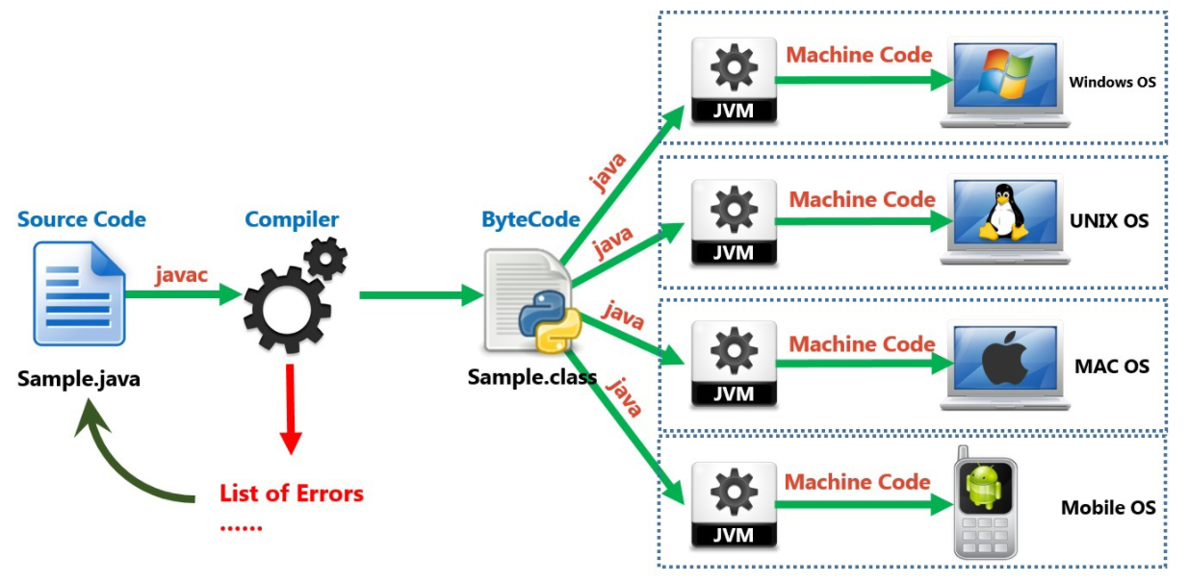

Slide 19
Java Data Types
Java programming language has a rich set of data types. The data type is a category of data stored in variables. In java, data types are classified into two types and they are as follows.
Primitive Data Types
Non-primitive Data Types

Slide 20
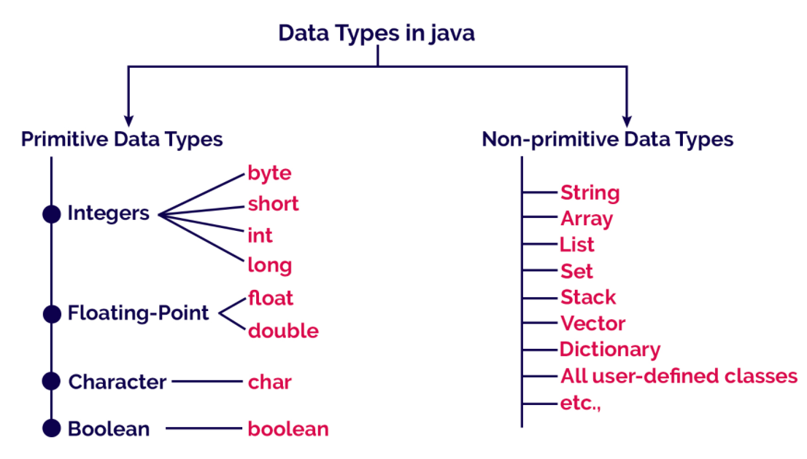

Slide 21
Primitive Data Types
The primitive data types are built-in data types and they specify the type of value stored in a variable and the memory size. The primitive data types do not have any additional methods.
In java, primitive datatypes includes byte, short, int, long, double, char and boolean.

Slide 22
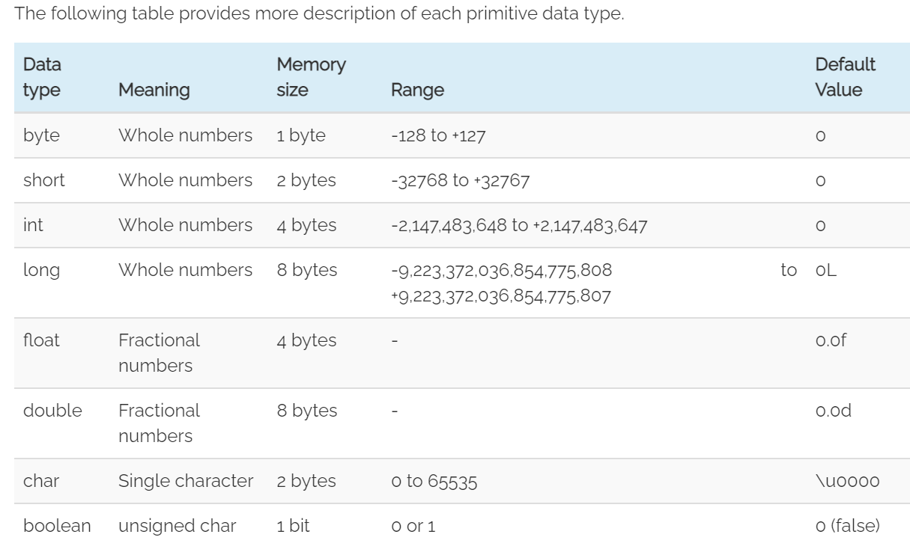

Slide 23
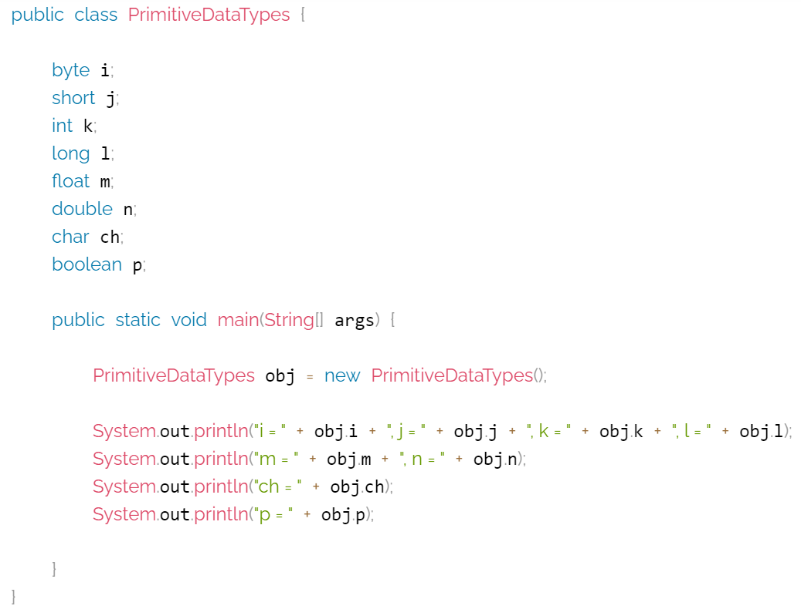


Slide 24
Public static void main(String[] args) is the most important Java method.
When you start learning java programming, this is the first method you encounter.
Remember the first Java Hello World program you wrote that runs and prints “Hello World”?
public static void main(String[] args)
Java main method is the entry point of any java program. Its syntax is always public static void main(String[] args).
You can only change the name of String array argument, for example you can change args to myStringArgs.
Also String array argument can be written as String... args or String args[].

Slide 25
Non-primitive Data Types
In java, non-primitive data types are the reference data types or user-created data types.
All non-primitive data types are implemented using object concepts.
Every variable of the non-primitive data type is an object. The non-primitive data types may use additional methods to perform certain operations.
The default value of non-primitive data type variable is null.
In java, examples of non-primitive data types are String, Array, List, Queue, Stack, Class, Interface, etc.

Slide 26
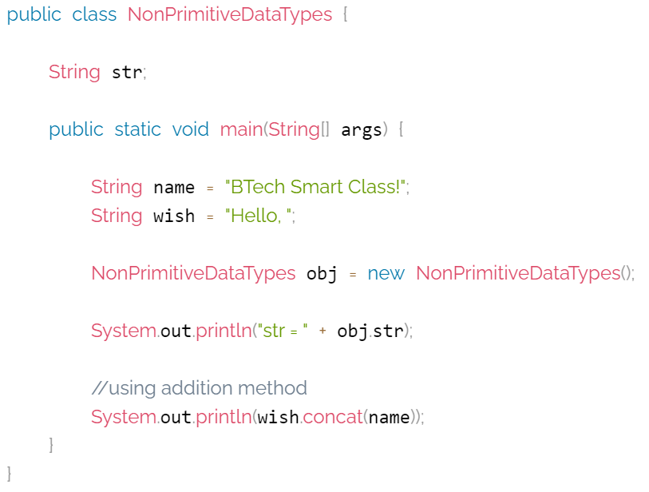
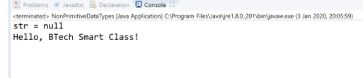

Slide 27
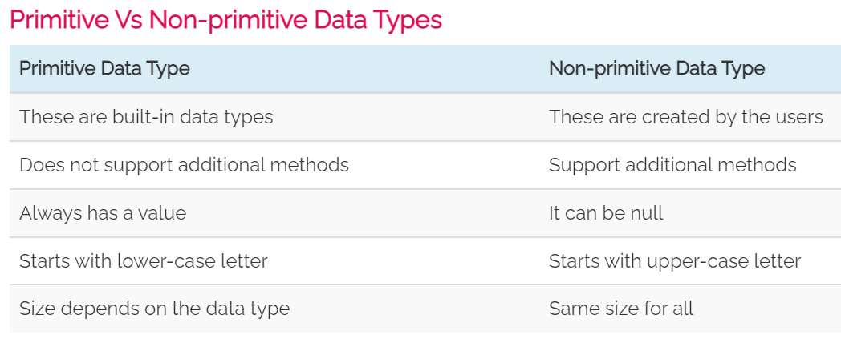
.

Slide 28
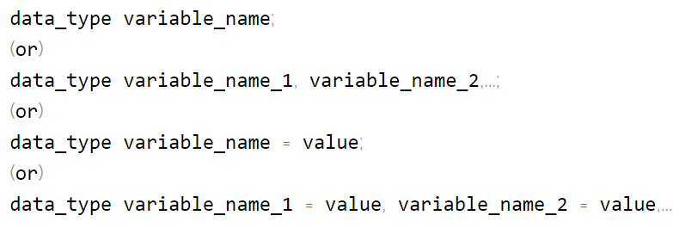
Java variables
A variable is a named memory location used to store a data value. A variable can be defined as a container that holds a data value.
In java, we use the following syntax to create variables

Slide 29
In java programming language variables are classified as follows.
Local variables
Instance variables or Member variables or Global variables
Static variables or Class variables
Final variables
Local variables
The variables declared inside a method or a block are known as local variables. A local variable is visible within the method in which it is declared.
The local variable is created when execution control enters into the method or block and destroyed after the method or block execution completed.

Slide 30
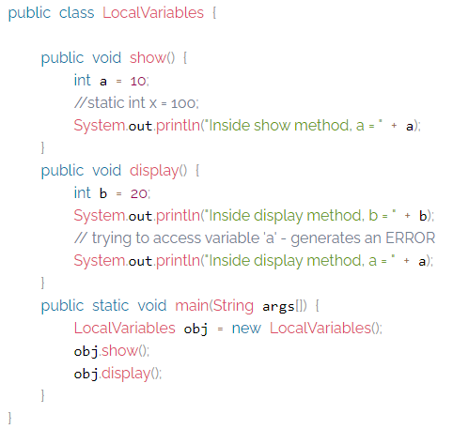
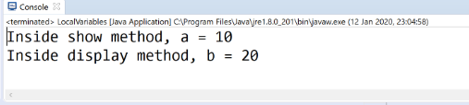

Slide 31
Instance variables or Member variables or Global variables
The variables declared inside a class and outside any method, constructor or block are known as member variables.
These variables are visible to all the methods of the class. The changes made to these variables by method affects all the methods in the class.
These variables are created separate copy for every object of that class.

Slide 32
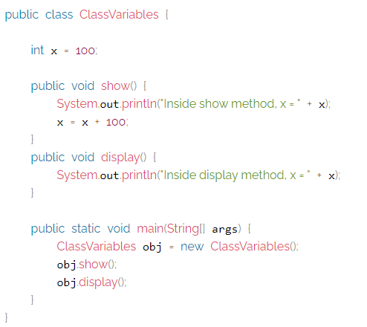


Slide 33
Static variables or Class variables
A static variable is a variable that declared using static keyword.
The instance variables can be static variables but local variables can not. Static variables are initialized only once, at the start of the program execution.
The static variable only has one copy per class irrespective of how many objects we create.
The static variable is access by using class name.

Slide 34
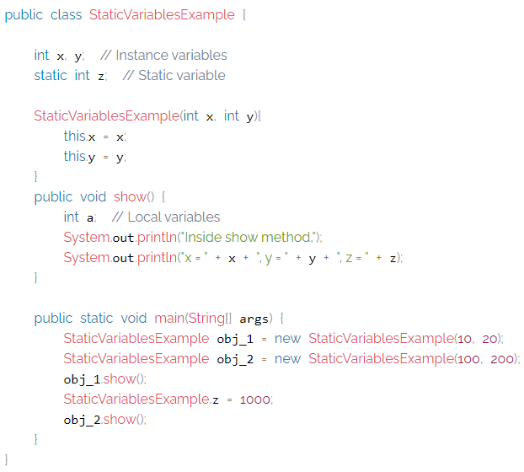


Slide 35
The this is a keyword in Java which is used as a reference to the object of the current class, with in an instance method or a constructor. Using this you can refer the members of a class such as constructors, variables and methods.
Final variables
A final variable is a variable that declared using final keyword.
The final variable is initialized only once, and does not allow any method to change it's value again.
The variable created using final keyword acts as constant.
All variables like local, instance, and static variables can be final variables.

Slide 36
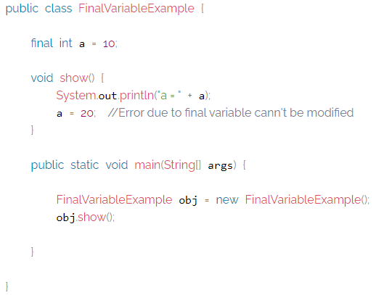


Slide 37
Operators
An operator is a symbol used to perform arithmetic and logical operations. Java provides a rich set of operators.
In java, operators are classified into the following four types.
Arithmetic Operators
Relational (or) Comparison Operators
Logical Operators
Assignment Operators
Bitwise Operators
Conditional Operators

Slide 38
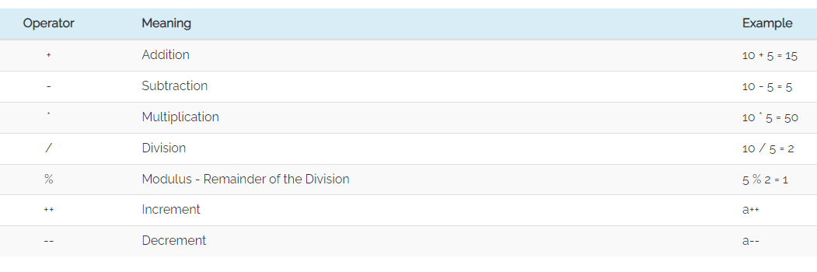
Arithmetic Operators
In java, arithmetic operators are used to performing basic mathematical operations like addition, subtraction, multiplication, division,modulus,increment,decrement,etc,.

Slide 39
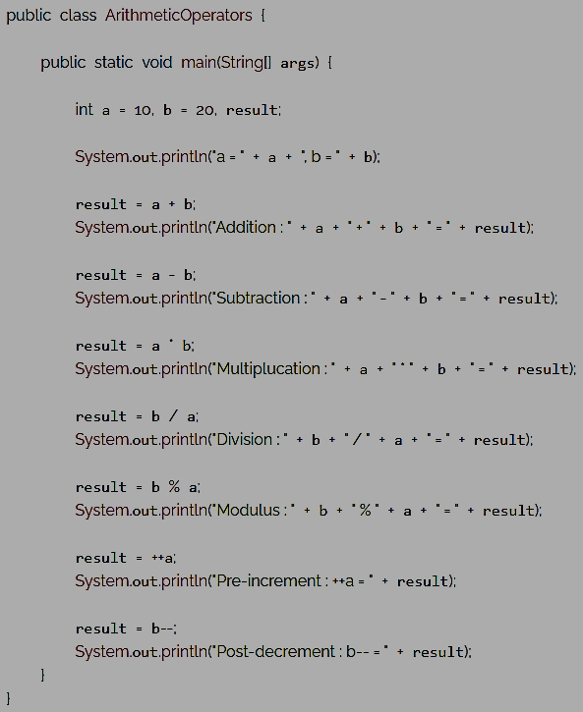
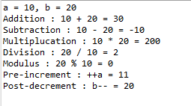

Slide 40
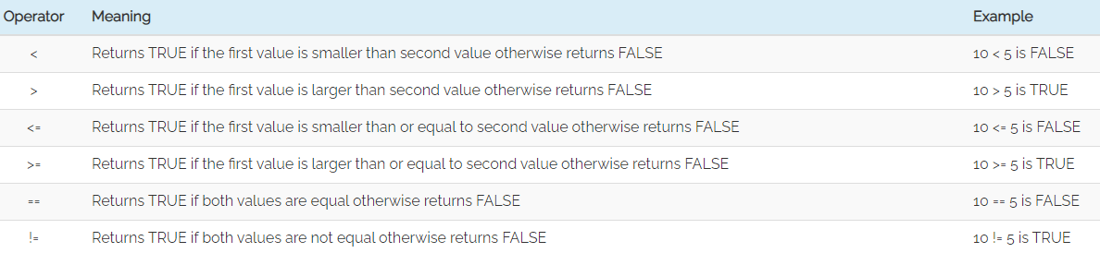
Relational Operators (<, >, <=, >=, ==, !=)
The relational operators are the symbols that are used to compare two values.
Every relational operator has two possible results either TRUE or FALSE. In simple words, the relational operators are used to define conditions in a program.
The following table provides information about relational operators.

Slide 41
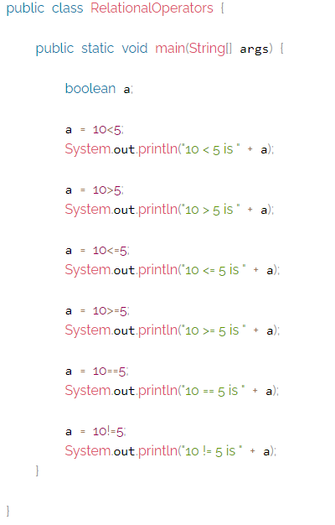
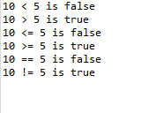

Slide 42
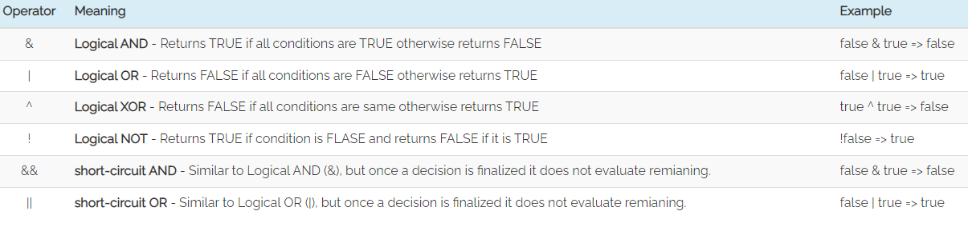
Logical Operators
The logical operators are the symbols that are used to combine multiple conditions into one condition.
The following table provides information about logical operators.

Slide 43
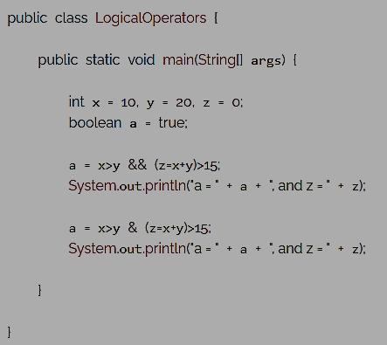

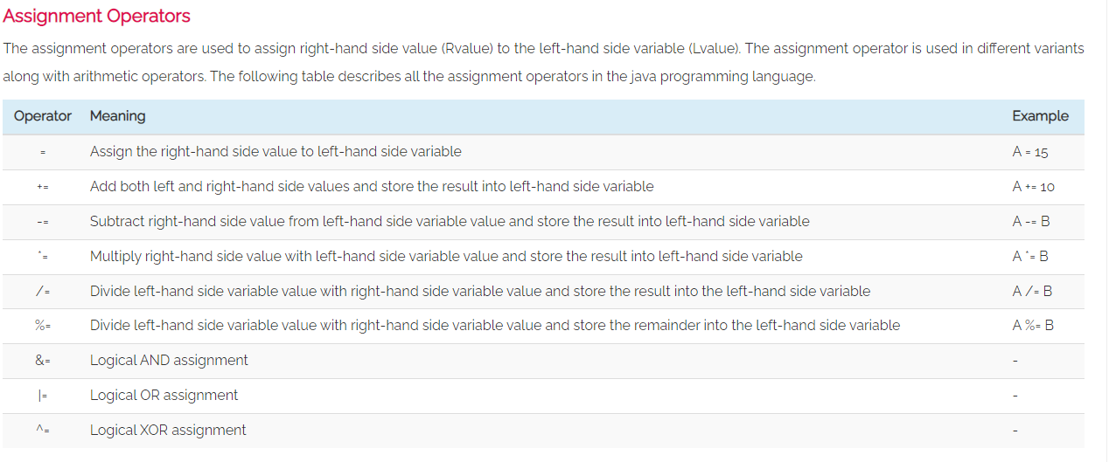

Slide 44
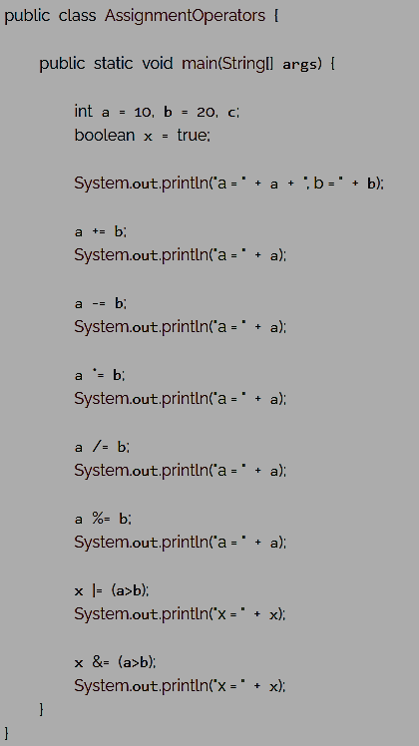
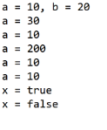

Slide 45
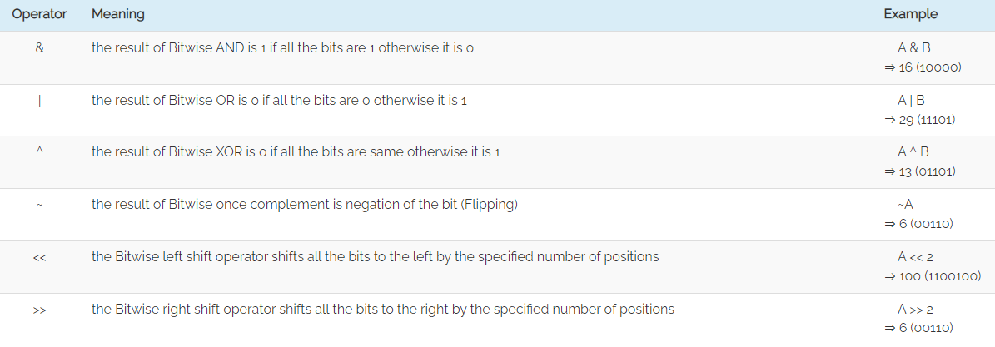
Bitwise Operators
The bitwise operators are used to perform bit-level operations in the java programming language.
When we use the bitwise operators, the operations are performed based on binary values.
The following table describes all the bitwise operators in the java programming language.

Slide 46
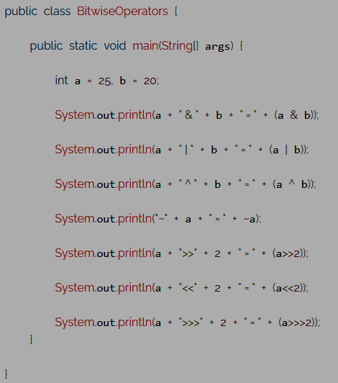
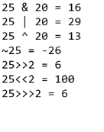

Slide 47
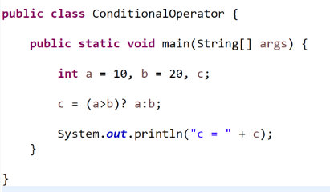

Conditional Operators
The conditional operator is also called a ternary operator because it requires three operands.
This operator is used for decision making. In this operator, first, we verify a condition, then we perform one operation out of the two operations based on the condition result.
If the condition is TRUE the first option is performed, if the condition is FALSE the second option is performed. The conditional operator is used with the following syntax.

Slide 48
Java Control Statements
In java, the default execution flow of a program is a sequential order. But the sequential order of execution flow may not be suitable for all situations.
Sometimes, we may want to jump from line to another line, we may want to skip a part of the program, or sometimes we may want to execute a part of the program again and again.
To solve this problem, java provides control statements.

Slide 49
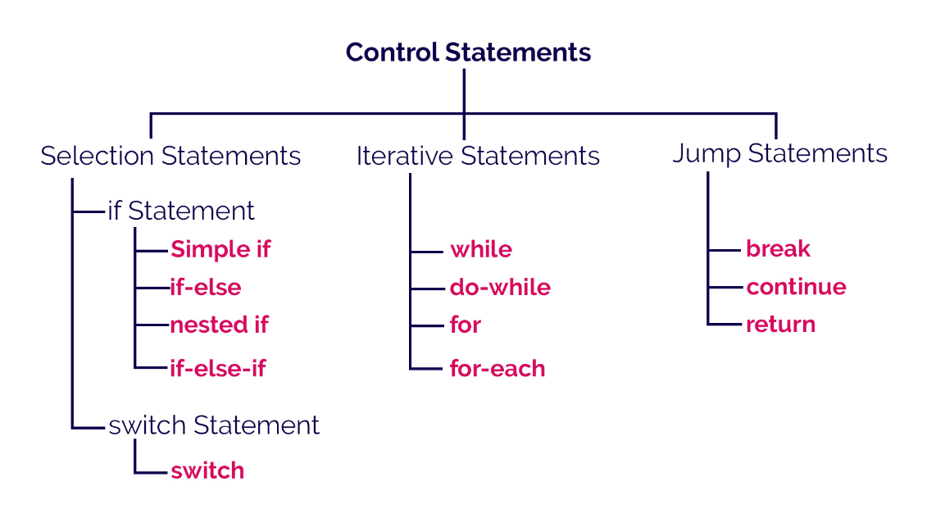

Slide 50
Selection Control Statements
In java, the selection statements are also known as decision making statements or branching statements.
The selection statements are used to select a part of the program to be executed based on a condition.
Java provides the following selection statements.
if statement
if-else statement
if-elseif statement
nested if statement
switch statement

Slide 51
Iterative Control Statements
In java, the iterative statements are also known as looping statements or repetitive statements.
The iterative statements are used to execute a part of the program repeatedly as long as the given condition is True.
Using iterative statements reduces the size of the code, reduces the code complexity, makes it more efficient, and increases the execution speed.
Java provides the following iterative statements.
while statement
do-while statement
for statement
for-each statement

Slide 52
Jump Statements
In java, the jump statements are used to terminate a block or take the execution control to the next iteration.
Java provides the following jump statements.
break
continue
return

Slide 53
Scanner Class
Scanner is a class in java.util package used for obtaining the input of the primitive types like int, double, etc. and strings. It is the easiest way to read input in a Java program, though not very efficient.
Scanner package - Scanner class allows user to take input from console. System.in is passed as a parameter in Scanner class. It tells the java compiler that system input will be provided through console(keyboard).
The nextInt(radix) method of java.util.Scanner class scans the next token of the input as a Int.

Slide 54
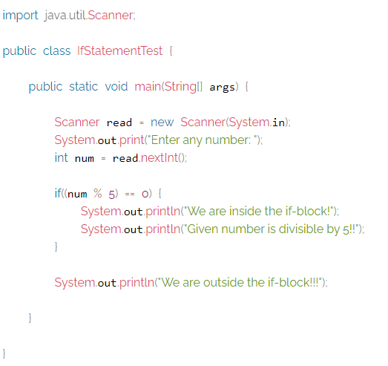
If Statement

Slide 55
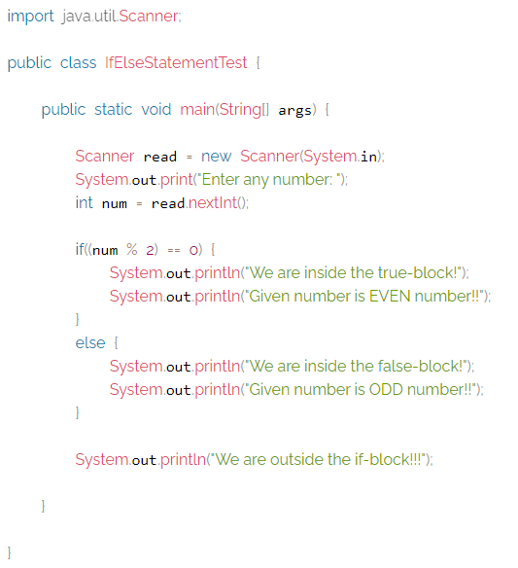
If-else statement

Slide 56
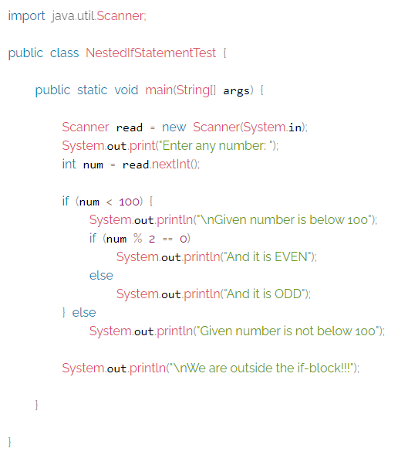
Nested If Statement

Slide 57
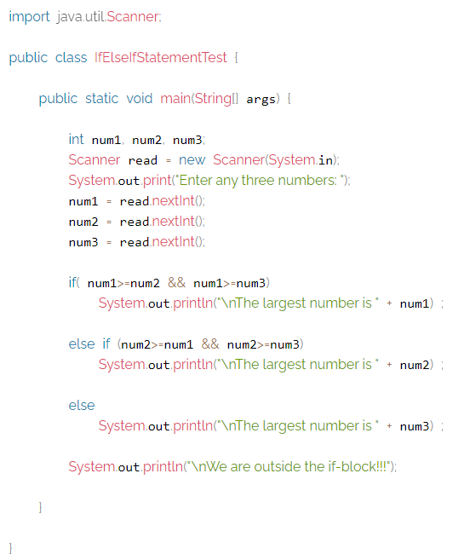
Else-If Statement

Slide 58
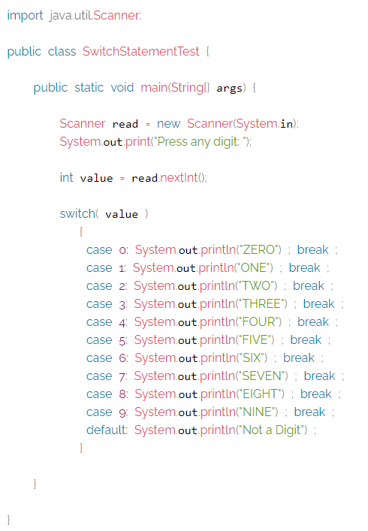
Switch Statement

Slide 59
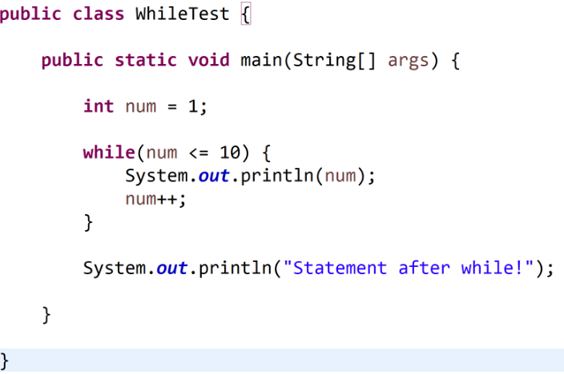

Slide 60
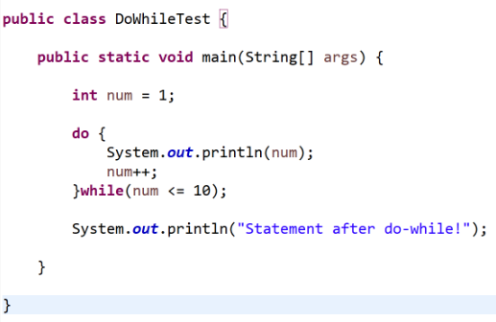

Slide 61
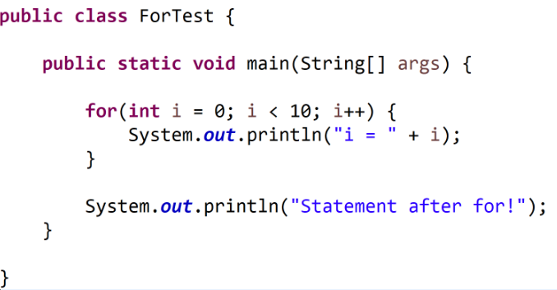

Slide 62
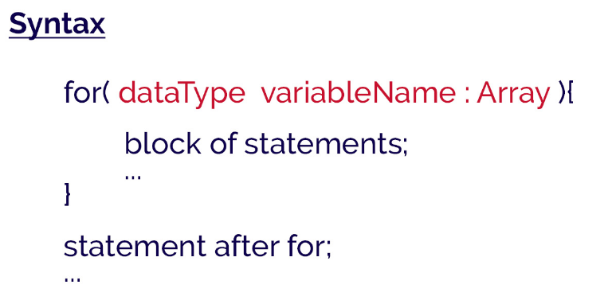
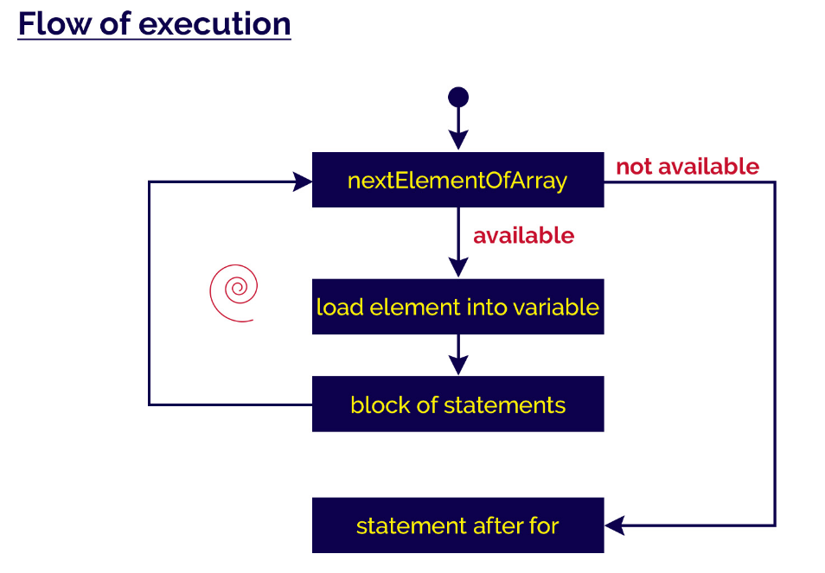
For-each Statement

Slide 63
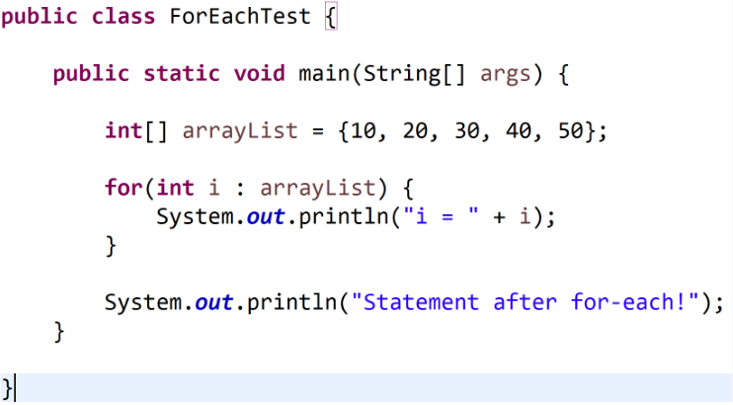
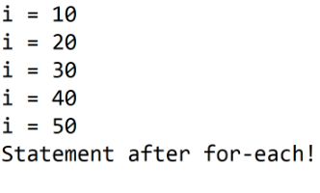

Slide 64
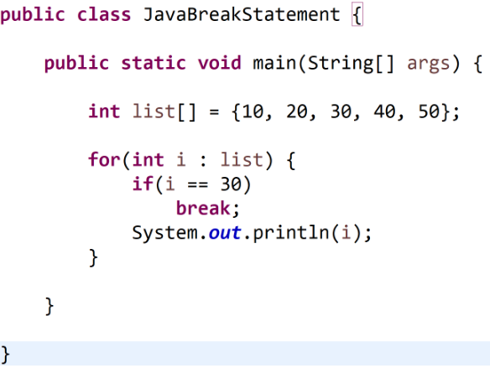

Slide 65
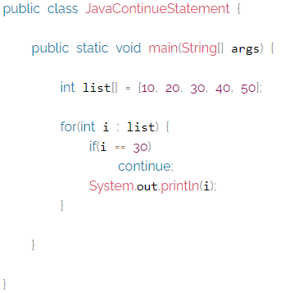

Slide 66
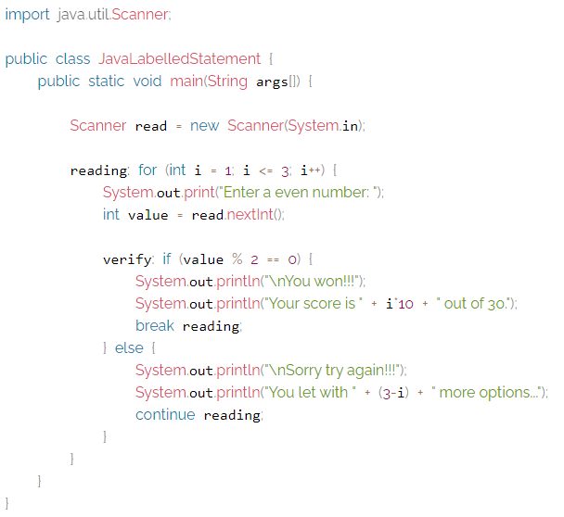
Labelled break and continue statement in java

Slide 67
Arrays
An array is a collection of similar data values with a single name. An array can also be defined as, a special type of variable that holds multiple values of the same data type at a time.
In java, arrays are objects and they are created dynamically using new operator.
Every array in java is organized using index values. The index value of an array starts with '0' and ends with ‘size-1'. We use the index value to access individual elements of an array.
In java, there are two types of arrays and they are as follows.
One Dimensional Array
Multi Dimensional Array

Slide 68
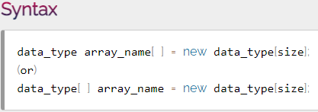
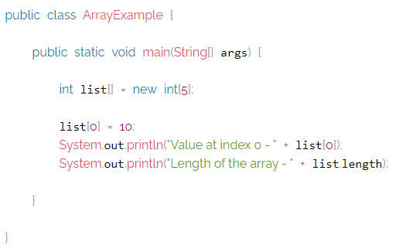

Creating an array
In the java programming language, an array must be created using new operator and with a specific size.
The size must be an integer value but not a byte, short, or long. We use the following syntax to create an array.

Slide 69
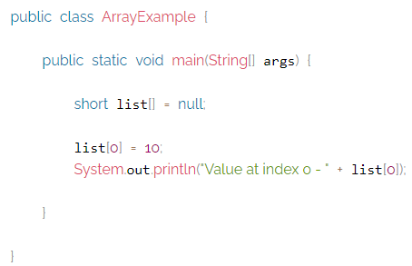

NullPointer Exception with Arrays
In java, an array created without size and initialized to null remains null only. It does not allow us to assign a value. When we try to assign a value it generates a NullPointerException.

Slide 70


ArrayIndexOutOfBoundsException with Arrays
In java, the JVM (Java Virtual Machine) throws ArrayIndexOutOfBoundsException. When an array is trying to access with an index value of negative value, value equal to array size, or value more than the array size.

Slide 71


Looping through an array
An entire array is accessed using either simple for statement or for-each statement. Look at the following example program to display sum of all the elements in a list.

Slide 72


Multidimensional Array
In java, we can create an array with multiple dimensions. We can create 2-dimensional, 3-dimensional, or any dimensional array.
In Java, multidimensional arrays are arrays of arrays. To create a multidimensional array variable, specify each additional index using another set of square brackets. We use the following syntax to create two-dimensional array.
Example

Slide 73
Java Class
Java is an object-oriented programming language, so everything in java program must be based on the object concept.
In a java programming language, the class concept defines the skeleton of an object.
The java class is a template of an object.
The class defines the blueprint of an object.
Every class in java forms a new data type.
Every class defines the properties and behaviors of an object.

Slide 74
All the objects of a class have the same properties and behaviors that were defined in the class.
Every class of java programming language has the following characteristics.
Identity - It is the name given to the class.
State - Represents data values that are associated with an object.
Behavior - Represents actions can be performed by an object.

Slide 75

Creating a Class
In java, we use the keyword class to create a class.
A class in java contains properties as variables and behaviors as methods. Following is the syntax of class in the java.

Slide 76

Creating an Object
In java, an object is an instance of a class. When an object of a class is created, the class is said to be instantiated.
All the objects that are created using a single class have the same properties and methods. But the value of properties is different for every object. Following is the syntax of class in the java.

Slide 77
Method
In general, a method is a way to perform some task. Similarly, the method in Java is a collection of instructions that performs a specific task. It provides the reusability of code.
A method is a block of code or collection of statements or a set of code grouped together to perform a certain task or operation. It is used to achieve the reusability of code. We write a method once and use it many times.

Slide 78

Method Declaration
The method declaration provides information about method attributes, such as visibility, return-type, name, and arguments. It has six components that are known as method header, as we have shown in the following figure.

Slide 79
Method Signature: Every method has a method signature. It is a part of the method declaration. It includes the method name and parameter list.
Access Specifier: Access specifier or modifier is the access type of the method. It specifies the visibility of the method. Java provides four types of access specifier:
Public: The method is accessible by all classes when we use public specifier in our application.
Private: When we use a private access specifier, the method is accessible only in the classes in which it is defined.
Protected: When we use protected access specifier, the method is accessible within the same package or subclasses in a different package.
Default: When we do not use any access specifier in the method declaration, Java uses default access specifier by default. It is visible only from the same package only.

Slide 80
Return Type: Return type is a data type that the method returns. It may have a primitive data type, object, collection, void, etc. If the method does not return anything, we use void keyword.
Method Name: It is a unique name that is used to define the name of a method. It must be corresponding to the functionality of the method.
Parameter List: It is the list of parameters separated by a comma and enclosed in the pair of parentheses. It contains the data type and variable name. If the method has no parameter, left the parentheses blank.
Method Body: It is a part of the method declaration. It contains all the actions to be performed. It is enclosed within the pair of curly braces.

Slide 81
Types of Method
There are two types of methods in Java:
Predefined Method
User-defined Method
In Java, predefined methods are the method that is already defined in the Java class libraries is known as predefined methods. It is also known as the standard library method or built-in method.
Some pre-defined methods are length(), equals(), compareTo(), sqrt(), etc.
Each and every predefined method is defined inside a class. Such as print() method is defined in the java.io.PrintStream class. It prints the statement that we write inside the method.

Slide 82


User-defined Method
The method written by the user or programmer is known as a user-defined method. These methods are modified according to the requirement.
How to Create a User-defined Method
Let's create a user defined method that checks the number is even or odd. First, we will define the method.

Slide 83


How to Call or Invoke a User-defined Method
Once we have defined a method, it should be called. The calling of a method in a program is simple. When we call or invoke a user-defined method, the program control transfer to the called method.

Slide 84
Static Method
A method that has static keyword is known as static method.
In other words, a method that belongs to a class rather than an instance of a class is known as a static method.
We can also create a static method by using the keyword static before the method name.
The main advantage of a static method is that we can call it without creating an object.
It can access static data members and also change the value of it. It is used to create an instance method. It is invoked by using the class name. The best example of a static method is the main() method.

Slide 85

Instance Method
The method of the class is known as an instance method. It is a non-static method defined in the class.
Before calling or invoking the instance method, it is necessary to create an object of its class. Let's see an example of an instance method.

Slide 86

InstanceMethodExample.java

Slide 87
There are two types of instance method:
Accessor Method
Mutator Method
Accessor Method: The method(s) that reads the instance variable(s) is known as the accessor method.
We can easily identify it because the method is prefixed with the word get. It is also known as getters. It returns the value of the private field. It is used to get the value of the private field.
Mutator Method: The method(s) read the instance variable(s) and also modify the values.
We can easily identify it because the method is prefixed with the word set. It is also known as setters or modifiers. It does not return anything. It accepts a parameter of the same data type that depends on the field. It is used to set the value of the private field.

Slide 88


Slide 89


OUTPUT

Slide 90


Abstract Method
The method that does not has method body is known as abstract method. In other words, without an implementation is known as abstract method. It always declares in the abstract class. To create an abstract method, we use the keyword abstract.
Syntax
abstract void method_name();

Slide 91
Constructors in Java
In Java, a constructor is a block of codes similar to the method. It is called when an instance of the class is created. At the time of calling constructor, memory for the object is allocated in the memory.
It is a special type of method which is used to initialize the object.
Every time an object is created using the new() keyword, at least one constructor is called.
It calls a default constructor if there is no constructor available in the class. In such case, Java compiler provides a default constructor by default.

Slide 92

Types of Java constructors
There are two types of constructors in Java:
Default constructor (no-arg constructor)
Parameterized constructor
Java Default Constructor
A constructor is called "Default Constructor" when it doesn't have any parameter.
Syntax of default constructor:
<class_name>(){}

Slide 93


Slide 94
Java Parameterized Constructor
A constructor which has a specific number of parameters is called a parameterized constructor.
Why use the parameterized constructor?
The parameterized constructor is used to provide different values to distinct objects. However, you can provide the same values also.
Example of parameterized constructor
In this example, we have created the constructor of Student class that have two parameters. We can have any number of parameters in the constructor.

Slide 95


Slide 96


Constructor Overloading in Java
In Java, a constructor is just like a method but without return type. It can also be overloaded like Java methods.
Constructor overloading in Java is a technique of having more than one constructor with different parameter lists.

Slide 97
Access Specifiers or Modifiers
In Java, the access specifiers (also known as access modifiers) used to restrict the scope or accessibility of a class, constructor, variable, method or data member of class and interface. There are four access specifiers, and their list is below.
default (or) no modifier
public
protected
private
In java, we can not employ all access specifiers on everything. The following table describes where we can apply the access specifiers.

Slide 98


Default: When no access modifier is specified for a class, method, or data member – It is said to be having the default access modifier by default.
The data members, class or methods which are not declared using any access modifiers i.e. having default access modifier are accessible only within the same package.
In this example, we will create two packages and the classes in the packages will be having the default access modifiers and we will try to access a class from one package from a class of the second package.

Slide 99


Private: The private access modifier is specified using the keyword private.
The methods or data members declared as private are accessible only within the class in which they are declared.
Any other class of the same package will not be able to access these members.
Top-level classes or interfaces can not be declared as private
Private means “only visible within the enclosing class”.

Slide 100


protected: The protected access modifier is specified using the keyword protected.
The methods or data members declared as protected are accessible within the same package or subclasses in different packages.
In this example, we will create two packages p1 and p2. Class A in p1 is made public, to access it in p2. The method display in class A is protected and class B is inherited from class A and this protected method is then accessed by creating an object of class B.

Slide 101


public: The public access modifier is specified using the keyword public.
The public access modifier has the widest scope among all other access modifiers.
Classes, methods, or data members that are declared as public are accessible from everywhere in the program. There is no restriction on the scope of public data members.

Slide 102

This Reference
The this keyword refers to the current object in a method or constructor.
The most common use of the this keyword is to eliminate the confusion between class attributes and parameters with the same name (because a class attribute is shadowed by a method or constructor parameter). If you omit the keyword in the example below, the output would be "0" instead of "5".
this can also be used to:
Invoke current class constructor
Invoke current class method
Return the current class object
Pass an argument in the method call
Pass an argument in the constructor call

Slide 103


Differentiate the instance variables from local variables if they have same names, within a constructor or a method.
Call one type of constructor (parametrized constructor or default) from other in a class. It is known as explicit constructor invocation.

Slide 104


Using this() to invoke current class constructor

Slide 105



Slide 106



Slide 107



Slide 108



Slide 109
Java String Class Methods
The java.lang.String class provides a lot of built-in methods that are used to manipulate string in Java. By the help of these methods, we can perform operations on String objects such as trimming, concatenating, converting, comparing, replacing strings etc.
Java String is a powerful concept because everything is treated as a String if you submit any form in window based, web based or mobile application.
Let's use some important methods of String class.
The Java String toUpperCase() method converts this String into uppercase letter and String toLowerCase() method into lowercase letter.

Slide 110







Slide 111
The String class trim() method eliminates white spaces before and after the String.
The method startsWith() checks whether the String starts with the letters passed as arguments and endsWith() method checks whether the String ends with the letters passed as arguments.
The String class charAt() method returns a character at specified index.
The String class length() method returns length of the specified String.
The String class valueOf() method coverts given type such as int, long, float, double, boolean, char and char array into String.
The String class replace() method replaces all occurrence of first sequence of character with second sequence of character.
String replaceString=s1.replace("Java","Kava");//replaces all occurrences of "Java" to "Kava"

Slide 112
Type Conversion and Casting
If you have previous programming experience, then you already know that it is fairly common to assign a value of one type to a variable of another type.
If the two types are compatible, then Java will perform the conversion automatically.
For example, it is always possible to assign an int value to a long variable.
However, not all types are compatible, and thus, not all type conversions are implicitly allowed.
Fortunately, it is still possible to obtain a conversion between incompatible types. To do so, you must use a cast, which performs an explicit conversion between incompatible types.

Slide 113
Java’s Automatic Conversions
When one type of data is assigned to another type of variable, an automatic type conversion will take place if the following two conditions are met:
The two types are compatible.
The destination type is larger than the source type.
When these two conditions are met, a widening conversion takes place.
Java also performs an automatic type conversion when storing a literal integer constant into variables of type byte, short, long, or char.

Slide 114

Casting Incompatible Type
To create a conversion between two incompatible types, you must use a cast. A cast is simply an explicit type conversion. It has this general form
(target-type) value
Here, target-type specifies the desired type to convert the specified value to.
For example, the following fragment casts an int to a byte. If the integer’s value is larger than the range of a byte, it will be reduced modulo (the remainder of an integer division by the) byte’s range.
A different type of conversion will occur when a floating-point value is assigned to an integer type: truncation.
For example, if the value 1.23 is assigned to an integer, the resulting value will simply be 1.

Slide 115


The following program demonstrates some type conversions that require casts

Slide 116

Automatic Type Promotion in Expression
In addition to assignments, there is another place where certain type conversions may occur: in expressions.
In an expression, the precision required of an intermediate value will sometimes exceed the range of either operand. For example, examine the following expression.
The result of the intermediate term a*b easily exceeds the range of either of its byte operands.
To handle this kind of problem, Java automatically promotes each byte, short, or char operand to int when evaluating an expression.
This means that the subexpression a*b is performed using integers—not bytes.

Slide 117
The Type Promotion Rule
Java defines several type promotion rules that apply to expressions. They are as follows:
First, all byte, short, and char values are promoted to int, as just described.
Then, if one operand is a long, the whole expression is promoted to long.
If one operand is a float, the entire expression is promoted to float.
If any of the operands is double, the result is double.

Slide 118

In the first subexpression, f * b, b is promoted to a float and the result of the subexpression is float. Next, in the subexpression i/c, c is promoted to int, and the result is of type int. Then, in d*s, the value of s is promoted to double, and the type of the subexpression is double. Finally, these three intermediate values, float, int, and double, are considered. The outcome of float plus an int is a float. Then the resultant float minus the last double is promoted to double, which is the type for the final result of the expression.

